Slide 1
HOSPITAL FINDER
PIP104 PROFESSIONAL PRACTICE-II
VIVA-VOCE
Batch Number:UP-151
Roll Number | Student Name
20201CSE0058 | MODEPALLI VENKATA SATHWIK REDDY
20201CSE0068 | HARSHITHA GOWDA R
20201CSE0018 | SAI VIKAS G
20201CSE0028 | VINISHA
Under the Supervision of,
Dr. Saritha K
Associate Professor – Selection Grade
School of Computer Science Engineering
Presidency University

Slide 2
Introduction
The internet has become an essential part of our daily lives, and almost everyone has access to it. People can use web applications through smartphones and laptops to communicate with a vast population seamlessly. Many households have people with health issues like cholesterol, blood pressure, and heart problems that require constant monitoring. Fortunately, various health-related apps are available on the Google Play store, and new ones are uploaded daily. These apps help manage health-related issues, including hospital locations, appointment scheduling, medicine reminders, and more.
A health-based web application goes a step further by making it easier and more accessible to manage one's health. Such applications are designed to cater to the specific needs of people with health issues, and they can make a significant difference in managing chronic conditions. For example, Hospital Finder is a web application that helps users to book appointments based on specific requirements, book appointments based on doctors' availability, and manage patient data. To ensure that the Hospital Finder web application is useful and easy to use, it is essential to regularly update hospital and doctor information. This can help users make informed decisions about their healthcare needs and make the process of finding and booking appointments more seamless.
So, web applications have revolutionized the healthcare industry and made it easier to manage health-related issues. With the right information and tools at their disposal, people can take charge of their health and make informed decisions about their well-being.

Slide 3
Literature Review
(Online appointment System, Venkatesh Rallapalli, Dipti Menghani, Hema Gallani, Gaytri Aasija, Dr. Dashrath Mane):
A standout feature is the system's provision of detailed doctor profiles, including specialization, experience, and other pertinent information. This empowers patients to make informed healthcare decisions, fostering a personalized approach. Additionally, patients can access reviews and ratings, aiding them in choosing the most suitable healthcare provider.
(A Doctor Appointment Booking System, D. Bharadwaja, Ch. Bhavya Sri, G. Aswani, G. Sushma, Ch. Prabhu Kiran ):
The application prioritizes advanced security features to safeguard the privacy and confidentiality of patient information, ensuring a trustworthy healthcare management platform.
(ANDROID-BASED HOSPITAL FINDER APPLICATION USING GLOBAL POSITIONING SYSTEM(GPS), Devayani.Ga, Hari Priya.R, Sruthi.S, C.Senthil Kumar, Assistant Professor):
The focus of this paper is on the latest generation of smartphones that utilize Global Positioning System (GPS) technology to locate the nearest hospitals and provide directions through Google Maps.
(Implementation of Hospital-Finder \, Shivam Bajpai, Tushar Modi, Vatsalya Vinay Sinha, Vidhi Jaiswal):
The primary focus of this paper is to discuss the utilization of location-based services that aim to enhance the overall functionality of smartphones by providing users with relevant information retrieval services based on their current location

Slide 4
Literature Review
(GPS-Based Android Application for Healthcare Dissemination ,Ajay Kumar G R, Akash Aman, Avinash Kumar, Harshith L):
The primary objective of this research paper is to develop a highly advanced and comprehensive system that can accurately predict diseases based on the symptoms exhibited by the patients. Additionally, the system aims to provide users with a seamless and hassle-free navigation system that helps them locate hospitals offering the required medical services.
(Android-Based Patient’s Healthcare Management System, Sajeetha Thavareesan):
This research paper delves into the features and functionality of an innovative healthcare application called "MyCare." This application has been designed to provide a comprehensive solution for managing and tracking physical signs and daily activities related to health.
Domain-Specific Search of the Nearest Hospital and Healthcare Management System GANAPATHI SHANKAR , DR. D. SUBBA RAO:
This paper discusses the importance of electronic health records in mobile healthcare systems. It also mentions the benefits of the system for senior people and chronic patients. They use cloud computing technology for storing and retrieving health information. It mentions the functionality of the system, such as tracking the optimal hospital and generating electronic health records.
Medilog – A Social Friendly Android Application for Maintaining Medical Logs And Locating Health Centers Bhuvaneswari A, Swathi N
This paper focuses on a project Medilog which is a mobile application that stores patient medical records, allowing doctors to access them by entering the patient's mobile number and generating an OTP, while also providing many features . It also includes features such as pill reminders and a nearby hospital finder.

Slide 5
Research Gaps Identified
To ensure that users can reach their intended medical facility without any difficulty, it is of utmost importance to input the precise address of the hospital within the application.
To ensure users privacy and prevent data theft, we can utilize various cryptographic methods to secure reports and data.
One of the ways we can enhance the healthcare service is by introducing video call appointments for patients to consult doctors remotely.
To improve the facilities, we can incorporate a feature to book an ambulance.
Accessing reliable and up-to-date ratings for hospital facilities, doctors, and treatments is essential for making informed decisions about healthcare

Slide 6
Proposed Methodology
To successfully carry out a project or develop a product, it is important to go through a series of phases.
Phases of the project:
Research: This involves conducting a thorough investigation to gather information necessary for the project or our product development.
Prototyping: In this phase, a preliminary version of the product was created to determine its design and functionality.
Testing: The prototype was then subjected to various tests to evaluate its performance and identify any issues or flaws.
Implementation: Once the prototype has been refined and tested, it is ready to be implemented or launched. This involves creating the final version of the product and making it available for use by the intended audience. The web application can be designed to be user-friendly and accessible to all patients of all ages and backgrounds. the phases will be iterative with regular testing and feedback from users to ensure the application meets their meets.
Software and tools used are-
HTML - Hypertext Markup Language is a standard markup language used to create basic web pages and applications.
CSS - Cascading Style Sheets is a style sheet language used for describing the presentation of a document written in HTML or XML.
JavaScript - A high-level, interpreted programming language that is used to make web pages interactive and dynamic.
XAMPP - A free and open-source cross-platform web server solution stack package developed by Apache Friends, consisting mainly of the Apache HTTP Server, MariaDB database, and interpreters for scripts written in the PHP and Perl programming languages.
PHP - A popular server-side scripting language that is used to develop dynamic websites and web applications.
Windows 11 - The latest version of the Windows operating system, which features a revamped design, improved performance, and new productivity features. First, we need to identify the user needs that is to gather the list of hospitals and doctor's information, Online booking appointments, and customer support and feedback.

Slide 7
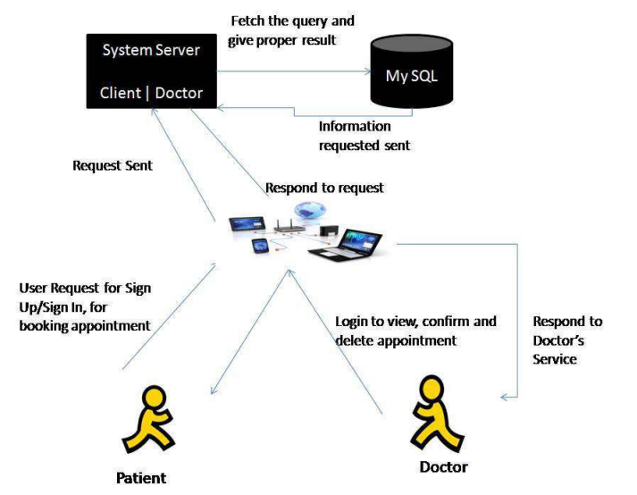
Proposed Methodology
Doctors-
Doctors are provided with an account through a web application by submitting their personal information such as their name, qualifications, and area of specialization. Upon successful registration, doctors now have the ability to log in using a unique username and password. Once logged in, they can easily view their scheduled appointments as well as upcoming appointments. In addition, doctors can accept appointment requests from patients if their availability permits, and can also upload their prescribed medications to the platform.
Patients-
To start using our platform, patients need to create an account by providing some basic information such as their name, email address, age, and a secure password. Once they have logged in, they can easily book appointments with their preferred doctor and manage their appointments through our user-friendly interface. Patients have the convenience of accessing their complete medical history, which includes all the details about the medications prescribed by their doctor after consultation. This feature helps patients to gain a better understanding of their health and enables them to manage their health conditions more effectively.
Admin-
In medical settings, an admin plays a critical role as a mediator between the healthcare providers and patients. They are responsible for managing the appointments, ensuring that the patients receive the care they need while taking into account the doctors' availability. The admin acts as a bridge between the two parties, approving or declining the appointments based on the doctors' schedules and expertise so that patients can receive quality healthcare services.

Slide 8
Objectives
Our healthcare communication system aims to provide seamless and efficient communication between patients, doctors, and other stakeholders. This helps to ensure that healthcare services are delivered in a timely and effective manner.
To establish a comprehensive framework that will facilitate the provision of healthcare services to a larger number of citizens, regardless of their location or financial status.
The application is designed to offer users comprehensive information about medical practitioners and healthcare facilities, presenting in-depth profiles that include their websites, physical addresses, and contact details.
Our goal is to develop a mobile platform that is designed to deliver a wide range of services that are both cost-effective and meet certain pre-established standards of quality.
To develop a software application that can be utilized effortlessly by its users without requiring them to acquire any new skills or knowledge.

Slide 9
System Design & Implementation
We use PHP and a SQL Server database in the project module to manage website details. The project is composed of three modules:
Admin.
Doctor.
Patient.
OVERVIEW SESSIONS AVAILABLE
VIEW PATIENTS
VIEW OR SEARCH DOCTORS
VIEW DOCTORS, PATIENTS
ACCEPT/REJECT APPOINTMENT
BOOK/ CANCEL
APPOINTMENT
DOC+
DOC+
DOC+
ADMIN
DOCTOR
PATIENT
VIEW APPOINTMENTS
VIEW REPORTS
CHECK UPDATES ON APPOINTMENTS
LOGOUT
UPDATE THEIR DETAILS
UPDATE THEIR DETAILS
ADMIN ACTIVITY DATA FLOW DIAGRAM
DOCTOR ACTIVITY DATA FLOW DIAGRAM
PATIENT ACTIVITY DATA FLOW DIAGRAM

Slide 10
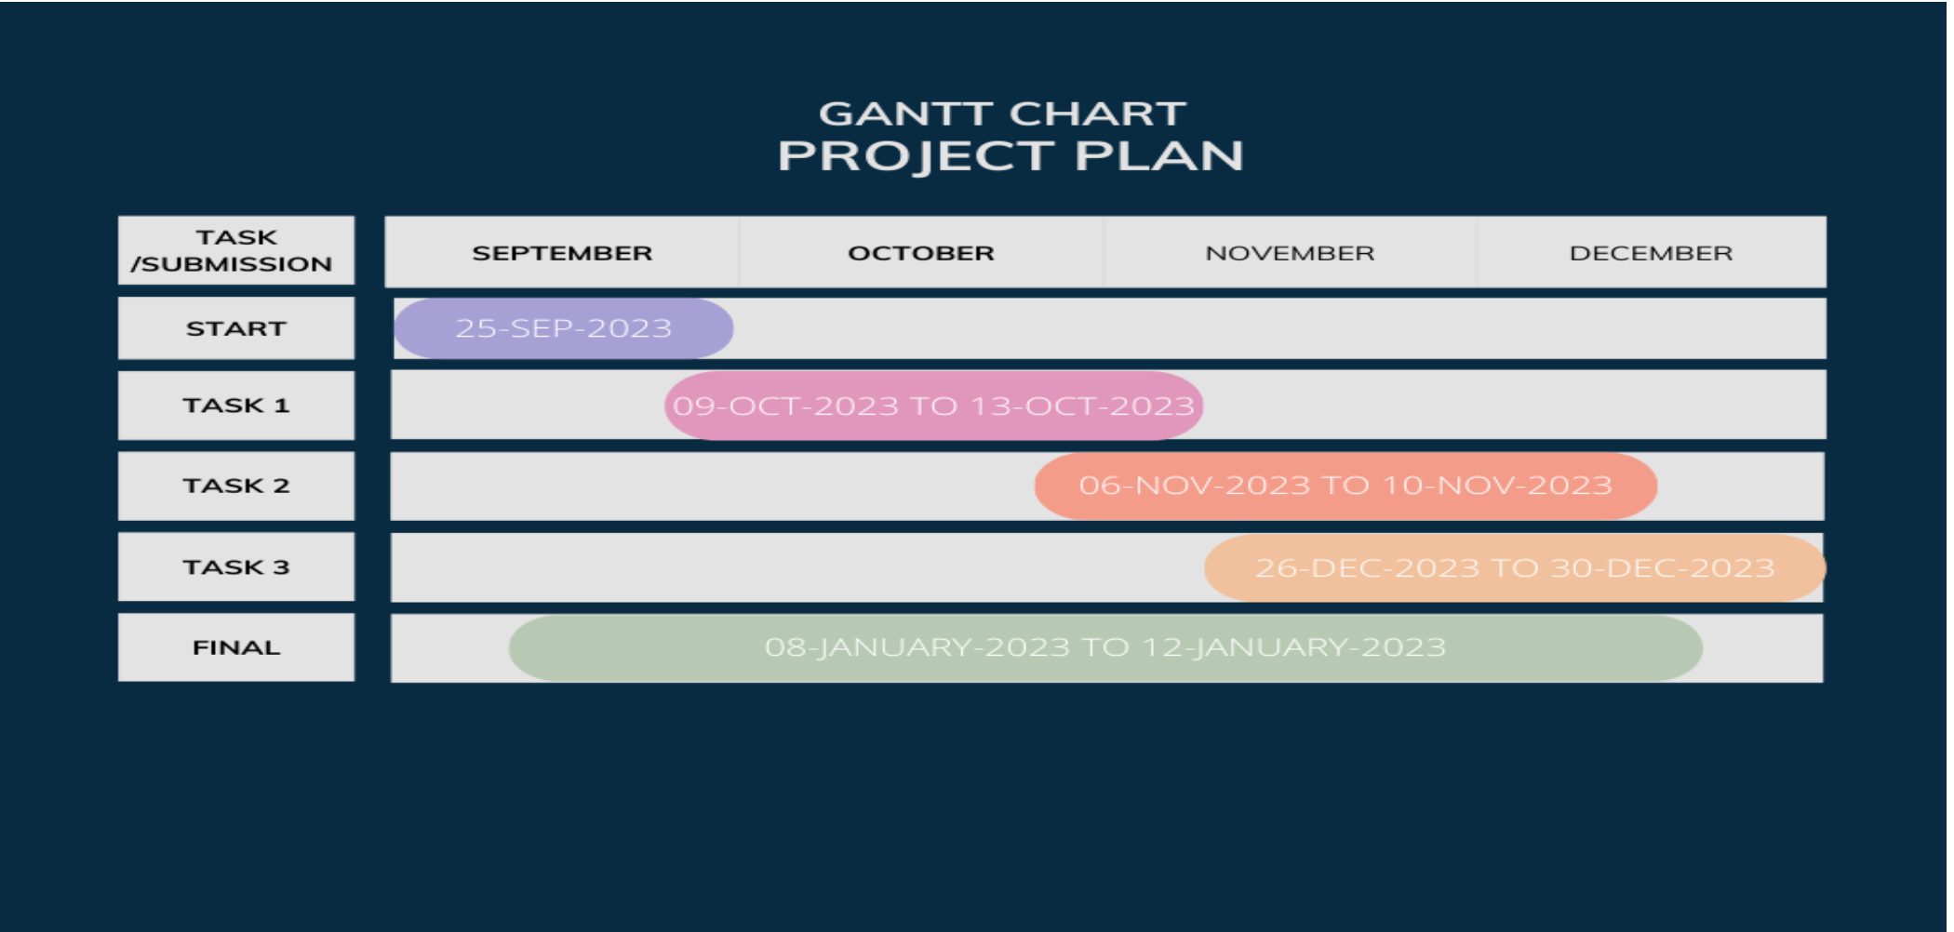
Timeline of Project

Slide 11
Outcomes / Results Obtained
Patients can easily search for hospitals or doctors and book appointments online, saving time and reducing wait times.
This tool is designed to assist patients in identifying and selecting healthcare providers whose expertise and medical specialties align with their individual health needs. By using this tool, patients can easily schedule appointments with the most suitable doctor and receive the best possible medical care.
Once a patient books an appointment with a doctor, the appointment details - including the date and time will be automatically added to both the patient and doctor's dashboard. This feature serves as a helpful reminder for both parties to ensure that they don't forget about the scheduled appointment. By having the appointment information readily available in their respective dashboards, they can easily check the date and time without having to search through their emails or notes.
There are several positive outcomes. Firstly, it provides patients with an easy-to-use platform to search for hospitals and book appointments online, which saves them time and reduces waiting times. Additionally, the application allows patients to choose the right specialist based on their medical condition, which ensures that they receive the appropriate care and treatment they need. This application also provides patients with valuable information about the medical specialties offered, the qualifications of the physicians, and the availability of slots for appointments, which helps patients to become more informed about their healthcare needs.

Slide 12
Conclusion
Our web application has been meticulously crafted to provide users with a comprehensive and detailed overview of hospitals in their city. Our goal is to empower patients seeking healthcare services, especially those in areas with limited resources, by equipping them with relevant and up-to-date information about nearby healthcare facilities.
Our application simplifies the process of finding out about the specialities, locations, and other critical details of hospitals, thereby enabling users to make informed decisions about their healthcare needs.
We firmly believe that by reducing wait times and enhancing the overall utilization of healthcare services, our application can make a significant difference in the lives of patients and their families.
During the development of this application, we encountered a significant challenge in obtaining precise and real-time data from the hospital's database regarding the medical services they provide.
During our research, we found that crucial information regarding directions to hospitals is often missing when searching for hospital-related information. This can lead to confusion and delays in emergency situations. Our web application serves as a valuable solution to this problem by providing comprehensive information about hospitals, including directions, making it a valuable tool to have in times of need, especially in this digital age.

Slide 13
References
International Journal of Scientific and Research Publications, Volume X, Issue X, Month 2018 Online Appointment System,Venkatesh Rallapalli, Dipti Menghani, Hema Gallani, Gaytri Aasija Dr. Dashrath Mane,( https://www.ijera.com/papers/vol12no4/Ser-3/I1204034852.pdf)
A Doctor Appointment Booking System,D. Bharadwaja, Ch. Bhavya Sri, G. Aswani, G. Sushma, Ch. Prabhu Kiran (https://www.ijarsct.co.in/Paper7601.pdf)
ANDROID-BASED HOSPITAL FINDER APPLICATION USING GLOBAL POSITIONING SYSTEM(GPS), Devayani.Ga, Hari Priya. R, Sruthi.S, C.Senthil Kumar,AssistantProfessor,(https://www.academia.edu/36350507/ANDROID_BASED_HOSPITAL_FINDER_APPLICATION_USING_GLOBAL_POSITIONING_SYSTEM_GPS)
Implementation of Hospital-Finder,Shivam Bajpai, Tushar Modi, Vatsalya Vinay Sinha, Vidhi Jaiswal,( https://ijrpr.com/uploads/V4ISSUE4/IJRPR11857.pdf)
Android Application for Healthcare Dissemination Ajay Kumar G R, Akash Aman, Avinash Kumar, Harshith L,(https://www.irjet.net/archives/V4/i4/IRJET-V4I4369.pdf)
Android Based Patient’s Healthcare Management System, Sajeetha Thavareesan,(https://www.seu.ac.lk/jisit/publication/v1n1/paper1.pdf)
Domain-Specific Search of the Nearest Hospital and Healthcare Management System GANAPATHI SHANKAR , DR. D. SUBBA RAO( https://www.ijatir.org/uploads/613452IJATIR5059-297.pdf )
Medilog – A Social Friendly Android Application for Maintaining Medical Logs And Locating Health Centres Bhuvaneswari A, Swathi N( https://eudl.eu/doi/10.4108/eai.7-12-2021.2314542 )

Slide 14
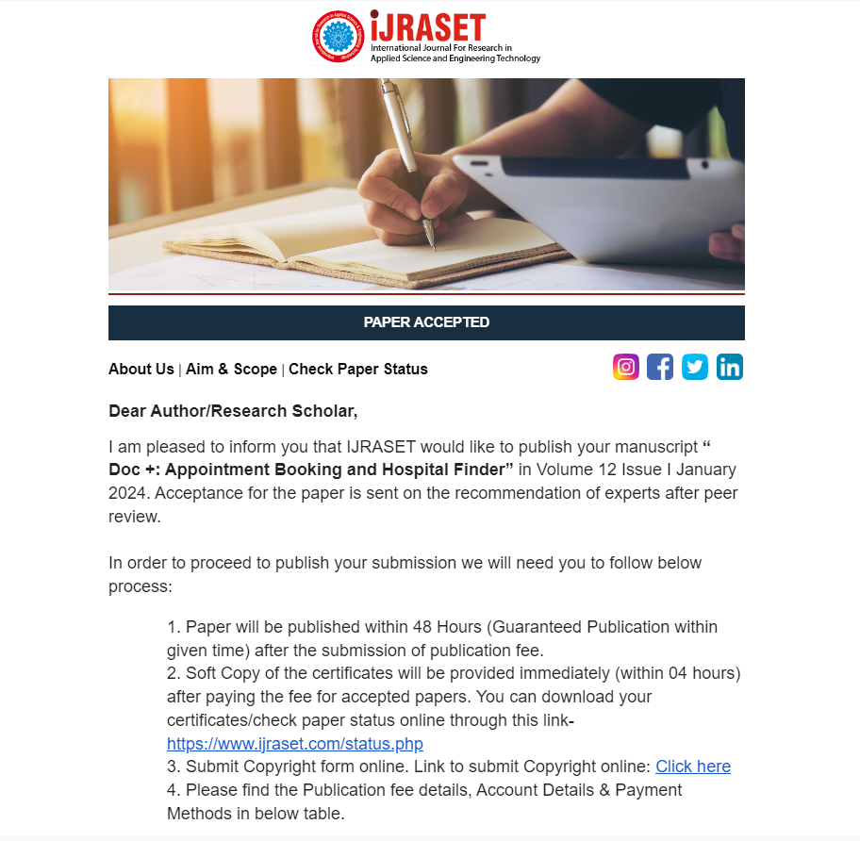
Publication Details

Slide 15

Thank You

